Slide 1
OCR
Developing and Deploying Applications with Streamlit

Slide 2
Agenda
What is OCR?
Installing OCR Library
Coding OCR
Demo OCR Streamlit Application

Slide 3
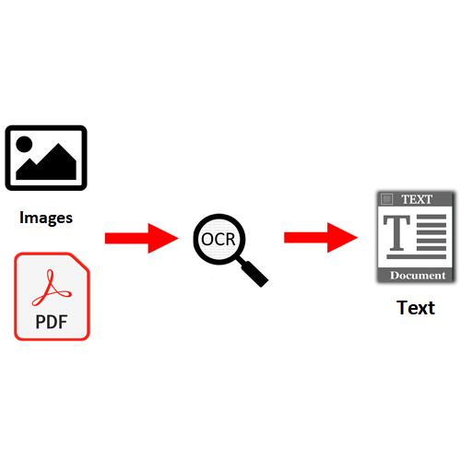
What is OCR?
Optical character recognition or optical character reader is the electronic conversion of images of typed, handwritten or printed text into machine-encoded text, whether from a scanned document, a photo of a document, a scene-photo or from subtitle text superimposed on an image.

Slide 4
Installing OCR libraries we need
How do I resolve a TesseractNotFoundError?
On Windows
pip install tesseract-ocr
pip install tesseract
pip install pytesseract
conda install -c conda-forge tesseract
Go to: https://github.com/UB-Mannheim/tesseract/wiki

Slide 5
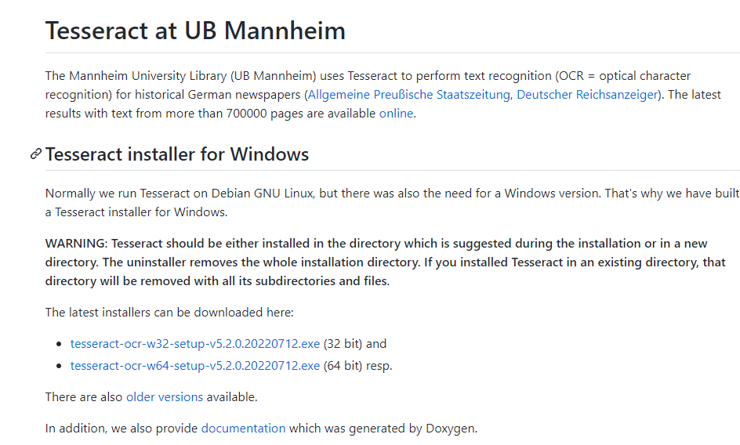
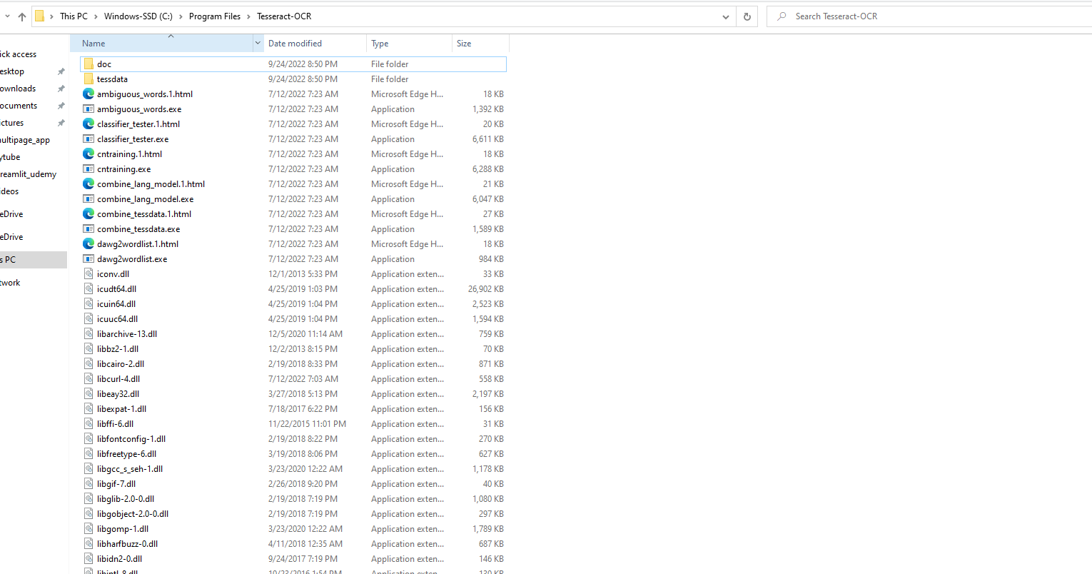
Installing OCR libraries we need ( Windows)
Install the exe based on 32 or 64 bit

Slide 6
Installing OCR libraries we need ( MAC )
/usr/local/Cellar/tesseract/3.05.02/bin/tesseract
pytesseract.pytesseract.tesseract_cmd = r"/usr/bin/tesseract"
For Mac OS
Try finding where the tesseract.exe is- if you installed it using brew, on your the terminal use:
> brew list tesseract
This should list where your tesseract.exe is, somewhere more or less like ( not found brew install tesseract)
> /usr/local/Cellar/tesseract/3.05.02/bin/tesseract
pytesseract.pytesseract.tesseract_cmd = r'<full_path_to_your_tesseract_executable>'
For Linux OS
sudo apt update
# This will update your packages
sudo apt install tesseract-ocr
# This will install OCR
sudo apt install libtesseract-dev
# This will add it as development dependency
pytesseract.pytesseract.tesseract_cmd = r"/usr/bin/tesseract"

